Slide 1
Predicting Pneumonia & MRSA in Hospital Patients
Team
Lavanya Basava Raju
Ryan Borowicz
Xiurong Lin
Ananya Mishra
Predictive Analytics
MSBA 6420
12/8/16

Slide 2
Agenda
Project Background & Goals
Business Understanding
Data Understanding & Data Preparation
Modeling & Evaluation
Deployment
Conclusions & Next Steps

Slide 3
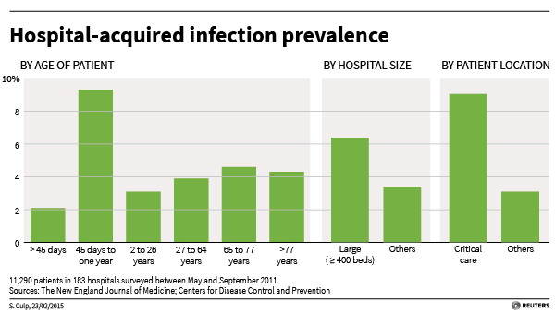
1.7 Million Hospital-Acquired Infections (HAI) Cause or Contribute to up to 99,000 Deaths Each Year
Causes:
Health care staff
Contaminated equipment
Bed linens
Air droplets
Other patients
Costs:
Tangible: Average of $30,000 per patient - Hospital not reimbursed
Cost of preventative treatment under $500
Intangible: Patient welfare, hospital reputation and compliance issues
Notes:
Business Understanding:
1) Hospital Impact – Tangible (costs of patient care for re-admittance) & intangible (reputation, compliance reqs)
2) Patient Impact – sickness, loss of trust in healthcare system leads to avoiding future preventative visits
3) Additional impacts on other hospital staff members, pharmacists, etc.
4) Data mining solution will try to take proactive preventative approach to addressing problem as opposed to current reactive plan which is expensive to the hospital and bad for all parties.

Slide 4
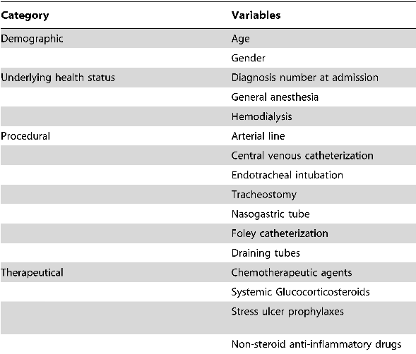
Use Predictive Modeling to Lower HealthCare Provider Costs and Improve Patient Outcomes
Informs Data Mining Contest 2008
Previous Research
“Predicting Hospital-Acquired Infections by Scoring System with Simple Parameters”
“Comparative impact of hospital-acquired infections on medical costs, length of hospital stay and outcome between community hospitals and medical centers”
Goal: Use Cost-Sensitive Predictive Modeling to help hospitals proactively address HAI’s
Notes:
Goal – Build a predictive model to classify hospital patients according to their likelihood of obtaining a hospital acquired infection (HAI) of pneumonia or MRSA
1) Predicting HAI’s
2) Informs data mining contest – 2006 - Original intention was to predict likelihood of HAI and patient re-admittance within 30 days – later changed to predicting pneumonia and coming up with cost model because the data did not have accurate target variables or associated rules for determining which records were - broke contest into two portions
3) Related Research

Slide 5




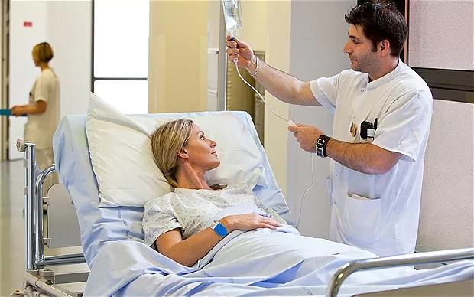
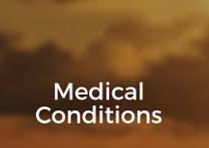



Data Understanding & Preparation Consumed the Majority of Time on the Project
Demographics
Hospital Events
Patient Conditions
Medications
Notes:
Data Understanding & Preparation:
1) 4 datasets – conditions, demographics, hospital visits, medications
2) Unclear target variable – ended up using all icd codes with V09 (msra) or between 480 & 486 (pneumonia)
3) Large number of missing values, incorrect data, lots of assumptions needed (with no answers available), highly time consuming data prep

Slide 6




Lack of Integrated Data Created Challenges in Merging the Datasets for Modeling
Patients between Hospital, Conditions, Medications and year not linked
Created data at patient level
Notes:
Data Understanding & Preparation (Cont.):
1) Issues in joining the different datasets – example of patient having 4 icd codes in conditions table, 1 of them in hospitals data, and 1 other in rx data
2) Led to having to create temporary tables for hospitals & medications datasets and using the variables from those as predictor variables – could lead to potential information loss
3) Final dataset includes large number of dummy variables – did this create any issues?

Slide 7



Seven Predictive Modeling Techniques Were Used to Classify Patients According to their Likelihood for Infection
Pre-processing
Modeling Techniques Used
Balanced Data
Normalize
Attribute Selection and Weighting
Principal Component Analysis (PCA)
Join to get data at patient level
Ensemble
Decision Tree
K-NN
Logistic Regression
Naïve Bayes
Neural Net
SVM
Notes:
Modeling:
Used R for Data Preparation and RapidMiner for Modeling
2) Discuss classification task and approach to solving
3) Discuss different models tried, parameters attempted, iteration process, etc.

Slide 8
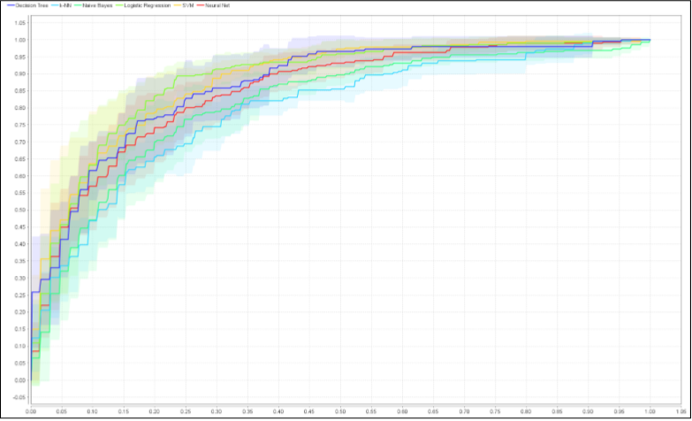
Logistic Regression and SVM Provide the Best Cost-Sensitive Classification Models
 | Accuracy % | Recall % | AUC | F-measure | Misclassification Cost | Fales Positives - Non-Infected Patients Requiring Preventive Measure
Decision Tree | 42.62 | 100 | 0.824 | 53.19 | 442.004 | 83 %
K-NN | 34.55 | 100 | 0.772 | 48.72 | 482.372 | 95 %
Logistic Regression | 62.34 | 100 | 0.882 | 64.23 | 343.400 | 53 %
Naïve Bayes | 48.72 | 100 | 0.846 | 55.50 | 411.502 | 74 %
Neural Networks | 55.65 | 100 | 0.852 | 59.16 | 376.859 | 64 %
SVM | 63.53 | 100 | 0.877 | 64.50 | 337.48 | 55 %
Marital status
Age
Race
No of Procedures
Type of Procedures
Type of Conditions
Type of Pharmacy
Notes:
Older the person higher is the likelihood of his getting the condition.
A single person is more prone to getting the condition.
White people are at higher risk for this condition.
Higher the number of procedures, higher is the chance of getting the condition.

Slide 9
Hospital savings by using the predictive models
Model | Current Costs | Costs with Predictive Models | Savings | Non-Infected Patients Requiring Preventive Measure
Logistic Regression | $8,576,761 | $4,900,261 | 42.8% | 53%
Support Vector Machine | $8,576,761 | $5,010,261 | 41.6% | 55%
Preventive Measure
$ 500 per patient
Cost of Treating the Infected Patient
$ 29,473 per patient

Slide 10

Deployment in Production Will Require a Cross-Functional Team Approach
IT Department
Build data pipeline to automate end-to-end processing
Physicians & Nurses
Use model outcomes in preventative treatment approach
Data/Business Analysts
Continuous evaluation and improvement of model in Production
Patient Intake Staff
Ensure data quality of patient responses
Notes:
Deployment:
Day-to-day business process (discuss issue of leakage – not all variables we used in model will be available for new patients – i.e. hospital charges, diagnosis code, prescription information , etc.)
Changes to IT infrastructure, data collection processes, hospital operations around intake process and patient records
Potential legal/compliance issues – what permission, if any, needs to be given by patient for taking the preventive medicine? What are the impacts/potential side effects of

Slide 11
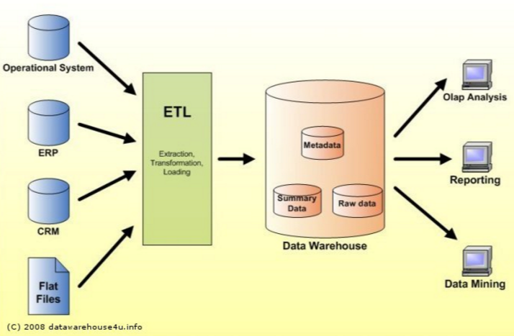
Improvements in Data Management Will Improve Model Outcomes
Integrated Electronic Health Record (EHR) system
Improved data collection and review procedures
Incorporate information from medical devices
Build additional health and lifestyle metrics into the model

Slide 12
Questions

